Slide 1
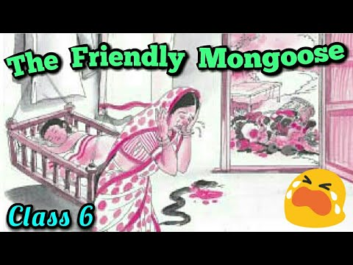

Slide 2
Introduction
This story talks about the human tendency to jump to conclusions hurriedly and how this tendency causes disturbance in the system. This moral is depicted through a farmer’s wife.

Slide 3
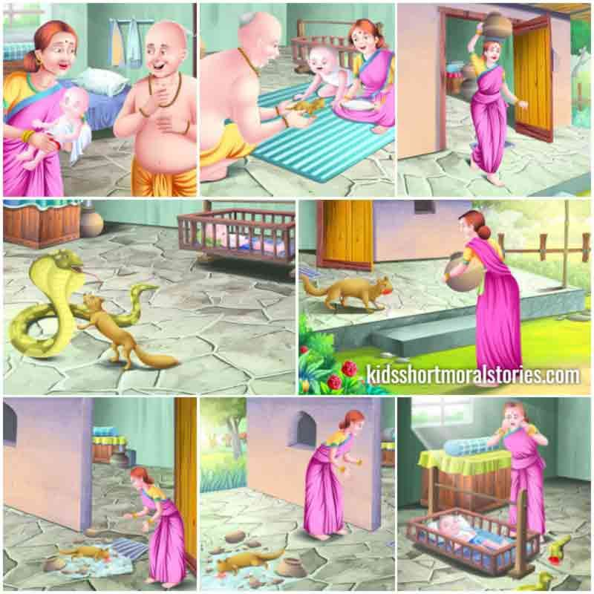

Slide 4
SUMMARY
There was a farmer. He lived with his wife and a small child in a village. One evening, the farmer brought a baby mongoose. He thought that the mongoose would be their son’s friend. The mongoose grew to its full size in five or six months. The farmer’s son was still a baby.

Slide 5
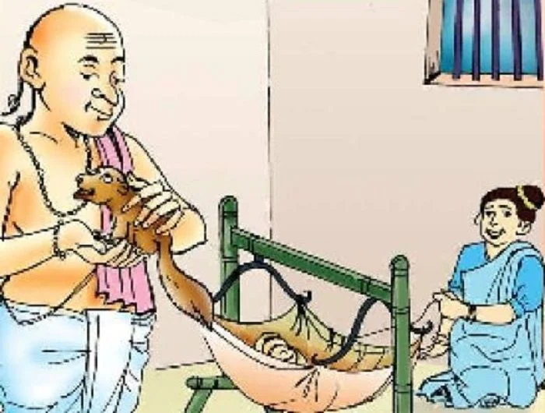

Slide 6
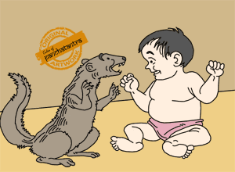

Slide 7
SUMMARY CONTD..
One day, the farmer’s wife went to the market. She asked her husband to keep an eye on the baby. The baby was sleeping in the cradle. She did not want to leave her child alone with the mongoose. Clearly she feared that the mongoose might harm her child. The farmer assured her not to be afraid. The farmer trusted the mongoose fully.

Slide 8
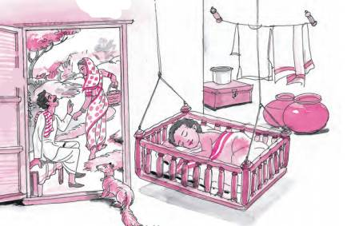

Slide 9
SUMMARY CONTD..
The farmer’s wife went to the market. The farmer also went to take a look at his fields soon after. The farmer’s wife returned home with a basketful of groceries. The mongoose was waiting for her at the door. He saw her and ran to welcome her. The farmer’s wife saw that the face and paws of the mongoose were smeared with blood.

Slide 10
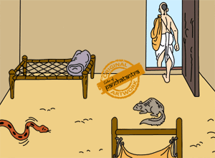

Slide 11
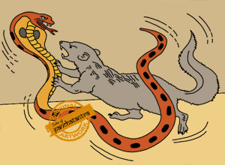

Slide 12
SUMMARY CONTD..
She thought that the mongoose had killed her son. So she hit the mongoose hard with her basket full of groceries. The mongoose died instantly. She ran inside. She saw her baby fast asleep. Nearby, a black snake lay dead in a pool of blood. She understood that the mongoose had killed the snake and saved her son. She repented over her rash and foolish action. She started sobbing but in vain. Her repentance shows that hurry causes worry.

Slide 13
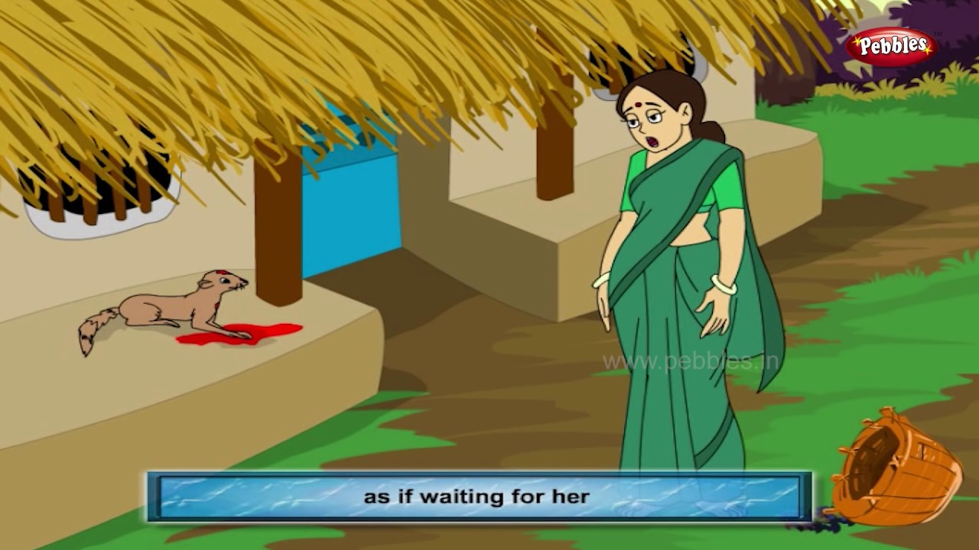

Slide 14
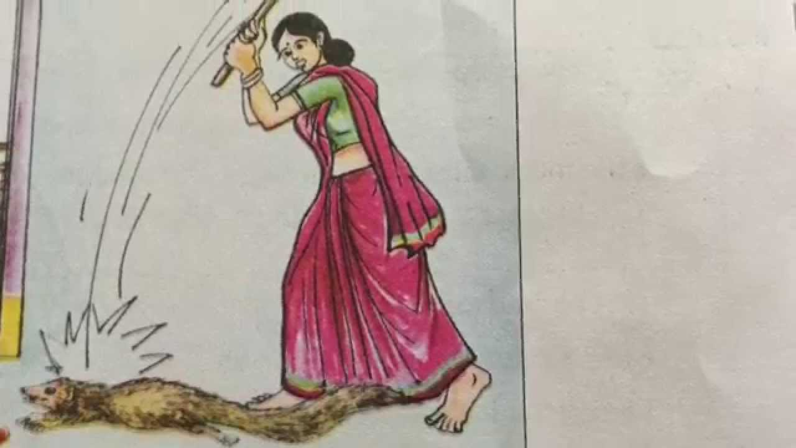

Slide 15
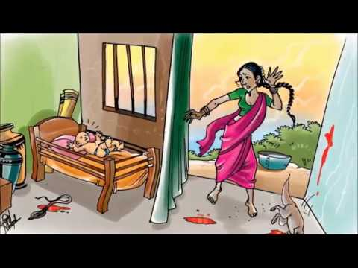

Slide 16
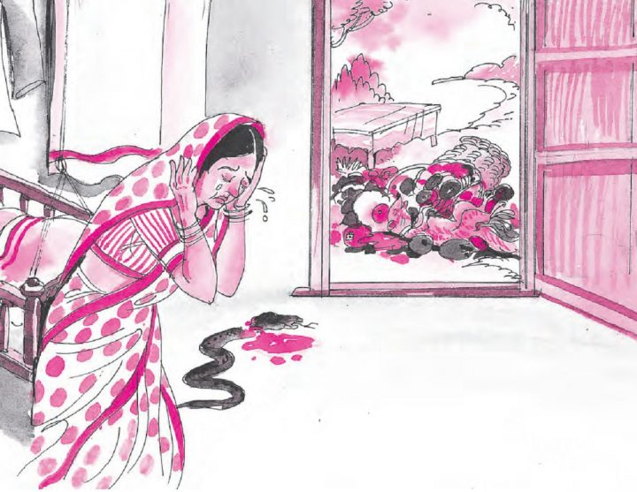

Slide 17
Moral of the Story
The moral of the story “The friendly Mongoose” is ‘Look before you leap’. It means that you need to think twice or thrice before doing anything. The smart thinking is vital because it will help you to avoid various problems and also reduce the possibility of facing complex problems

Slide 18
Words Meaning
Cradle :a small bed for a baby
Rocked : to move or sway from one side to another
Frankly : honestly

Slide 19
Q&A
1. Why did the farmer bring a baby mongoose into the house?
2. Why didn’t the farmer’s wife want to leave the baby alone with the mongoose?
3. What was the farmer’s comment on his wife’s fears?
4. Why did the farmer’s wife strike the mongoose with her basket?
5. Did she repent her hasty action? How does she show her repentance?

